Slide 1


VISVESVARAYA TECHNOLOGICAL UNIVERSITY JNANA SANGAMA, BELGAVI -590 014 Phase-1 Project On “VITAMIN DIFICIENCY DETECTION USING IMAGE PROCESSING AND NEURAL NETWORK” Submitted by Likhith Kumar V 4SM20CS029 Prasad C R V 4SM20CS050 Sandeep M N 4SM20CS067 Rahul R C 4SM20CS055
Under the Guidance of Project Coordinator Prof. Vinayaka V M B.E, M.Tech, Prof. Ramesh B E M.Tech, Asst. Prof., Dept. of CS&E, Assoc. Prof., Dept. of CS&E, SJMIT, Chitradurga. SJMIT, Chitradurga.
Head of the Department Prof. Poral Nagaraj B.E., MTech., Prof. & HOD., Dept. of CS&E, SJMIT, Chitradurga. DEPARTMENT OF COMPUTER SCIENCE AND ENGINEERING S J M INSTITUTE OF TECHNOLOGY CHITRADURGA-577502

Slide 2
“VITAMIN DIFICIENCY DETECTION USING IMAGE PROCESSING AND NEURAL NETWORK”

Slide 3
CONTENTS
ABSTRACT
INTRODUCTION
EXISTING SYSTEM
PROPOSED SYSTEM
METHODOLOGY
TOOLS AND TECHNOLOGIES USED
SOFTWARE AND HARDWARE REQUIREMENTS
INPUTS AND OUTPUTS
CONCLUSION
REFERENCES

Slide 4
ABSTRACT
We are developing an Android app focused on early vitamin deficiency detection.
Users can capture images of specific body parts, including eyes, lips, tongue, and nails, to receive basic advice on potential deficiencies.
The Android app is designed to be user-friendly, cost-effective, and economically accessible.
However, users should be aware that the app does not replace the expertise of healthcare professionals.
Seeking advice from doctors remains crucial for accurate diagnoses and tailored recommendations.
The project aims to deliver a practical and accessible tool for users to enhance awareness of their nutritional needs and potential deficiencies.

Slide 5
INTRODUCTION
Our app utilizes Convolutional Neural Networks (CNN) for image processing and Fuzzy Logic for decision-making.
All processing is done locally on the user's Android device using TensorFlow Lite.
Users can initiate a comprehensive analysis of potential deficiencies by capturing images of specific body organs: eyes, lips, tongue, and nails.
The sophisticated algorithm focuses on detecting indications related to vitamin B2, B3, B6, B12, and iron deficiencies, such as cracked lips, subtle changes in the tongue, and eyes.
Unlike traditional methods, the app processes the entire analysis locally, eliminating the need for cloud-based processing.
Users receive a detailed report, including recommended dietary adjustments to address the identified deficiencies.
The app addresses a global health concern, with over 2 billion people experiencing vitamin deficiencies.
While not a substitute for professional medical advice, the app serves as a valuable tool for individuals to monitor their nutritional health and seek appropriate guidance.

Slide 6
EXISTING SYSTEM
1. Accurate but Sluggish Process: The traditional system for vitamin deficiency detection, reliant on laboratory analyses and blood sample testing, is known for its accuracy.
2. Time-Consuming Procedures: One of the significant drawbacks is the time-consuming nature of the process, from sample collection to analysis and result reporting.
3. High Costs: The conventional approach is associated with high costs, limiting accessibility to a broader demographic.
4. Dependency on Specialized Facilities: The need for specialized facilities and trained medical professionals adds to the challenges, limiting scalability.

Slide 7
PROPOSED SYSTEM
1. Utilization of Modern Technologies: Our proposed Android application leverages advanced technologies, including Convolutional Neural Networks (CNN) and Fuzzy Logic.
2. Efficient Image Capture: Users can capture images of specific body parts, eliminating the need for invasive blood sample testing, resulting in a faster diagnostic process.
3. Cost-Effective Solution: By reducing the dependency on costly laboratory procedures, the proposed system aims to make vitamin deficiency screening more cost-effective and accessible.
4. Enhanced Convenience: The proposed system, in the form of our Android app, offers a user-friendly alternative that combines accuracy with enhanced convenience.

Slide 8
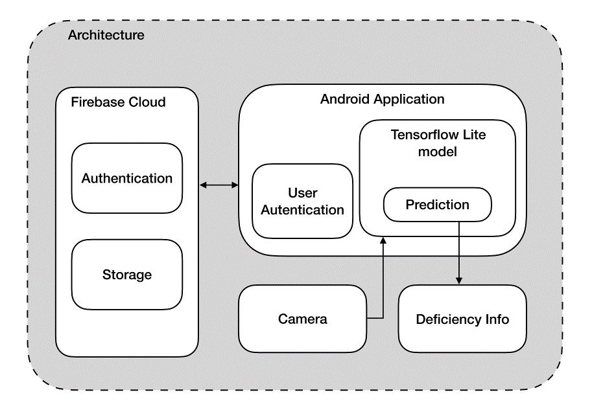
METHODOLOGY

Slide 9
TOOLS AND TECHNOLOGIES USED
Our project integrates a comprehensive set of tools and technologies to develop a robust vitamin deficiency detection app. Here's an overview of the key components:
1. TensorFlow:
- TensorFlow is utilized for model training in a cloud environment using Google Colab.
- It enables the creation and refinement of the Convolutional Neural Network (CNN) model, harnessing the capabilities of cloud computing for efficient processing.
2. TensorFlow Lite:
- TensorFlow Lite takes the trained model and facilitates its seamless integration into the Android app.
- The lightweight version is optimized for on-device processing, ensuring real-time analysis of user-captured images directly on Android devices.

Slide 10
3. Convolutional Neural Networks (CNN):
- The Convolutional Neural Network (CNN) is a specialized deep learning algorithm.
- It operates as a pivotal component in our system, serving to extract intricate features from images during both training and inference phases. This algorithm is essential for accurate image processing, enabling our app to identify visual cues related to vitamin deficiencies in specific body organs.
4. Android Studio:
- Android Studio serves as the primary integrated development environment (IDE) for building our Android app.
- It streamlines the development, testing, and deployment processes, ensuring a seamless user experience.

Slide 11
SOFTWARE AND HARD REQUIREMENTS
For development:
Operating system: Windows 10/11
Development environment: Android Studio
Processor: Minimum Intel i3 11th gen
RAM: Minimum 8Gb
Storage: Minimum 15Gb of free space
At User-End:
Smartphone with at least 5Mp camera
Operating system: Android 7 & above
RAM: Minimum 2Gb

Slide 12
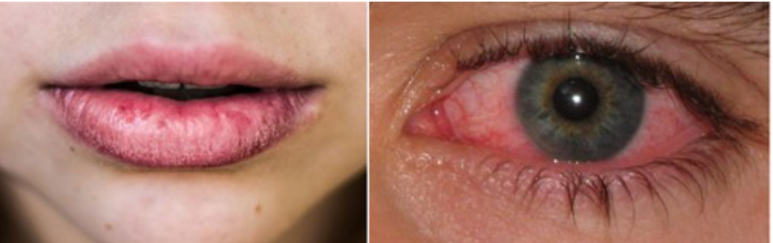
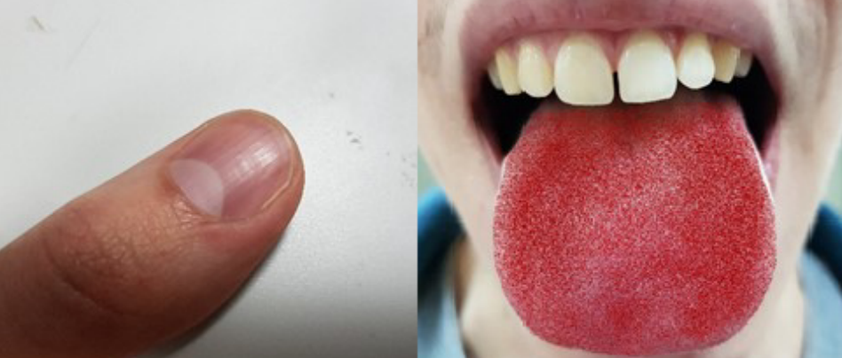
INPUTS AND OUTPUTS
Input:
User login information
User captured images of eyes, nails, lips, tongue.

Slide 13
Output:
Analysis Report: Our system provides a detailed report that tells you if you might be lacking essential vitamins like B2, B3, B6, B12, or iron.
Dietary Recommendations: If a deficiency is detected, the system suggests specific changes to your diet and recommends foods that can help you get the right nutrients.

Slide 14
CONCLUSION
Our Android app addresses the global challenge of vitamin deficiencies, impacting over 2 billion people.
We use Convolutional Neural Networks (CNN) for image processing and Fuzzy Logic for decision-making.
The app design allows users to easily capture images of their eyes, lips, tongue, and nails for a comprehensive deficiency analysis.
While not a substitute for professional medical advice, the app is a practical, economic, and user-friendly tool for individuals to monitor their nutritional health.
The project's significance lies in its potential to empower users with early detection and awareness of possible deficiencies.
The app effectively identifies subtle visual cues associated with vitamin B2, B3, B6, B12, and iron deficiencies, contributing to improved nutritional well-being.
It encourages users to seek appropriate guidance for a healthier lifestyle.

Slide 15
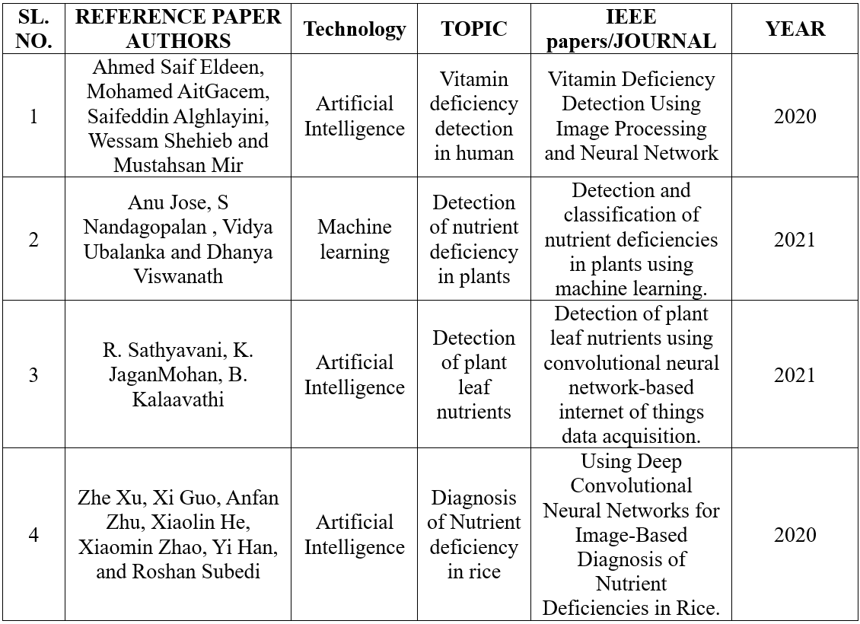

REFERENCES

Slide 16
Thank you….

